Slide 1
2018-2019 Bus Driver Con-Ed

Slide 2
Itinerary
Obtaining Your CDL and RSS Pocket Card
Renewing Your CDL and Pocket Card
New Corrective Action Policy for At-fault Accidents / Incident
General Reminders
Fire Emergencies

Slide 3
Obtaining you CDL and RSS Pocket Card
Many of you are duel contract employees with RSS. As part of your employment you are required to obtain you CDL with P&S endorsements and your RSS Pocket Card.
Questions:
What should I expect?
How do I start the process?
What should I do to help me prepare?

Slide 4
Obtaining you CDL and RSS Pocket Card
What should I expect?
You will have to attend the Bus Driver training classes.
Classes are held on the second floor of the main building of the Transportation Department on Old Concord Rd
The class consists of three days in the classroom and three days of road work
To pass the classroom portion, you will have to successfully pass four tests
General Knowledge
Air Brake
School Bus
Passenger

Slide 5
Obtaining you CDL and RSS Pocket Card
What should I expect? – After Successful Completion of Classroom
You MUST obtain a DOT Medical Card if you have not already done so.
You can obtain your DOT Medical Card by using this link:https://bib.com/ohs/rss and selecting the correct profile or by using your physician if they hold a DOT certification.
If using the website provided , be sure to print payment receipt and take with you to ProMed on W. Innes St. Call ahead to verify they are open and accepting DOT Physicals.
You will be reimbursed up to the contracted amount for the DOT Medical
After obtaining your DOT Medical Card, you will need to go to the DVM Office and get your CDL Permit
You will pay a $40 application fee
You will pay a $28 permit fee
You will need to have a Class B CDL with P&S and Non-Excepted Interstate

Slide 6
Obtaining you CDL and RSS Pocket Card
What should I expect? – After Obtaining CDL Permit
You will need to contact Rich Cleary at 704-245-6702 ext 7124 and schedule your road work. You will have to hold your permit 14 days before you will be able to start you road work.
After successful completion of the road work, you will return to the DVM to obtain your Class B CDL with P&S endorsements.
There will be a $84 fee for your license.
Return to the Transportation Office with all receipts and license to complete your Reimbursement form and get your Rowan County Pocket card.

Slide 7
Obtaining you CDL and RSS Pocket Card
What should I do to help me prepare?
Reviewing the Commercial Motor Vehicle License Manual with be very helpful. You will receive a manual from our DMV Training Specialist (Rich Cleary) on the first day of training. You can download a copy to review before class using this link: https://www.ncdot.gov/dmv/license-id/driver-licenses/new-drivers/Documents/commercial-driver-manual.pdf

Slide 8
Renewing Your CDL and Pocket Card
What are the steps to renewing?
You will need to have a valid DOT Medical Card.
If you do not have a valid card , you can use this link: https://bib.com/ohs/rss and select the DOT Medical tab

Slide 9
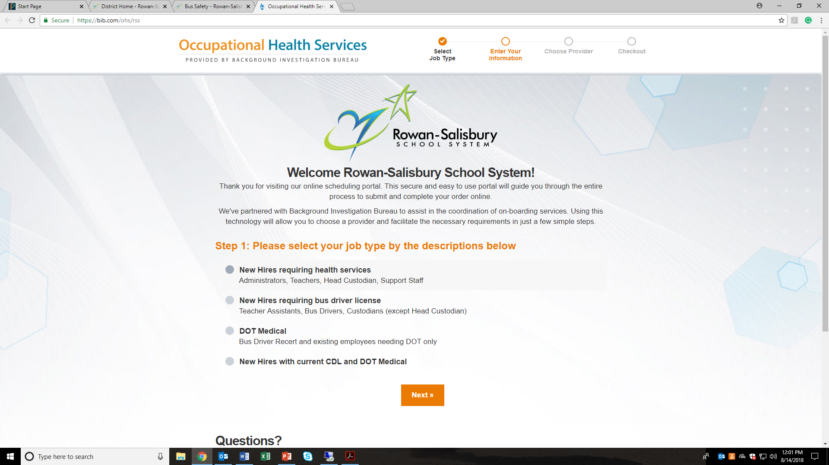
Renewing Your CDL and Pocket Card

Slide 10
Renewing Your CDL and Pocket Card
What are the steps to renewing?
Once you have received your DOT Medical Card, you will go to the DMV , present them with your DOT Medical Card and renew your Class B CDL with P&S endorsements.
They will give you a form to complete as to which physical you had. Choose the first box option – NON-ACCEPTED INTERSTATE
Again, KEEP YOUR RECEIPT AS YOU WILL BE REIMBURSED.
Contact Rich Cleary to schedule your renewal. After you successfully complete your renewal with Rich he will issue your pocket card and you are ready to drive.
PLEASE BE MINDFUL OF THE EXPIRATION DATE ON YOUR DOT PHYSICAL CARD. ALTHOUGH YOUR LICENSE ARE GOOD FOR (3) YEARS SOME DOT PHYSICALS ARE ONLY GOOD FOR ONE (1) ONE YEAR BUT ALL EXPIRE AFTER (2) YEARS.
YOU CAN RENEW UP TO 90 DAYS BEFORE EXPIRATION.

Slide 11
QUESTIONS ON CDL OR MEDICAL CARD???

Slide 12
ACCIDENT / INCIDENT REVIEW POLICY
We continue to see and will continue to see our vehicles involved in accidents and incidents. Drivers perform the duties daily under very stressful and demanding environment. Drivers deliver over 10,000 students each and every day, with little or no unwanted events occurring.
However, historically, we continue to have accidents and incidents that can be prevented. These events impacts our operations in many ways you are not aware of and at times has a large ripple effect throughout the transportation system.
This policy was developed to assist the Transportation Department to track accidents / incidents of drivers. The policy also establishes a review panel and a process for corrective action.

Slide 13
ACCIDENT / INCIDENT REVIEW POLICY
Effective Date: July 1st 2018
PURPOSE:
To define the in-house process for review of minor bus and minor van accident / incidents in which the Bus/Van driver is determined to be at-fault, regardless of whether or not charges are filed. The term “Accident / incident” and/or “Incident” is defined to mean any incident which results in property damage and/or personal injury, This will be the internal process followed to determine what, if any corrective action will be taken after involvement in an at-fault accident / incident.
APPLICATION:
This policy applies to all school bus, van and activity bus drivers.

Slide 14
ACCIDENT / INCIDENT REVIEW POLICY
PROCEDURE:
When an accident / incident occurs, the Driver must immediately report it to the Bus Garage via bus radio or phone call to the Transportation Department at 704-245-6702 and the driver shall remain at the scene and not move the vehicle until permission is received from a Transportation Department Official.
When a Driver is involved in an accident / incident, regardless of whether or not charges are filed, regardless of the amount of damage done, a Transportation Department Official will prepare and submit an accident / incident report (TD-25). This submission will include copies of all documents, photographs and videos pertaining to the accident / incident, and must be submitted immediately and no less than one (1) working day following the accident / incident.

Slide 15
ACCIDENT / INCIDENT REVIEW POLICY
A review panel including the Director of Transportation, Transportation Supervisor, Route Coordinator (and any other pertinent Transportation Official with knowledge of the accident / incident) will convene within a reasonable amount of time once all of the facts are gathered concerning the accident / incident. This review panel will evaluate the accident / incident documentation and assign a point value to the accident / incident utilizing the Accident / Incident Review Matrix below.
Within 5 days of the panel meeting date, the Director of Transportation will notify the Bus Driver in writing of the result of the review panel and any action that the panel directs or recommends the bus driver take. A copy of the panel’s written report will be provided to the Director of Transportation for review and consideration for submission to the Director of Human Resources or, for filing in the bus driver’s department file.

Slide 16
ACCIDENT / INCIDENT REVIEW POLICY
Drivers who receive a traffic citation for a moving violation while driving a RSS passenger vehicle could be subject to disciplinary action which may include suspension of their RSS driving privileges until the citation is resolved. The Division of Motor Vehicles (DMV) shall cancel the school bus certificate of any driver for the following reasons as stated in the NCDMV 19NCAC 03G.209. Conviction of any of the following motor vehicles moving offenses: passing a stopped school bus, careless and reckless driving, excessive speeding, following too close, violation while operating a school bus and/or activity bus. The complete listing can be located under “Cancellation of Bus Certification” found in the Drivers Handbook.

Slide 17
ACCIDENT / INCIDENT REVIEW POLICY
Bus / Van / Activity Bus Accident / Incident Review Matrix
When an accident / incident is determined to be the fault of the Driver whether or not charges are filed, the accident / incident review panel will review the accident / incident documentation, the bus driver’s NCDMV traffic record and internal driving history. The panel will then assign points (internal Transportation Department points) according to the following scale:

Slide 18
ACCIDENT / INCIDENT REVIEW POLICY
1. | Property damage up to $500 | 1-2
2. | Property damage $500 or more | 3
3. | Knowingly leaving the scene of the accident / incident | 3
4. | Student / passenger injury* | 6
5. | Minor injury to occupant of other vehicle(s) or pedestrian(s) | 4
6. | Major injury to occupant of other vehicle(s) or pedestrian(s) | 6
7. | Fatality due to the bus driver’s negligence of safety violation | 21
8. | Previous “at-fault” accident / incidents in 3-year period (each occurrence) | 0-3
9. | Past documented, confirmed complaints about the driver’s bus operating short comings, (including NCDMV Driver Education Specialist observations) | 0-3

Slide 19
ACCIDENT / INCIDENT REVIEW POLICY
Accident / incident points are accumulated and maintained Transportation Department File for a revolving three year period.
The point totals derived above will be placed on the outcome list below to determine the proposed corrective action.

Slide 20
ACCIDENT / INCIDENT REVIEW POLICY
Accident / incident Point Total | Proposed Corrective Action
1 to 5 points Property damage | Letter to department file, documenting accident / incident and board reviews.
1 to 5 points Property damage and/or minor personal injury | Post Certification Training (PCT) by NCDMV Driver Education Specialist in the specific area related to the cause of the accident / incident to be completed as soon as possible but no later than 30 days of panel review results. Letter to department file, documenting accident / incident and board review results.
6 to 20 points | Post Certification Training (PCT) by NCDMV Driver Education Specialist in the specific area related to the cause of the accident / incident to be completed as soon as possible but no later than 30 days of the panel review results. Appropriate disciplinary action, may be recommended to the Director of Human Resources depending on the severity.. Director of Transportation will address recertification.
NOTE: | Point accumulation shall not be the sole determining factor in recommendation for disciplinary action or termination of employment related to an accident / incident.

Slide 21
ACCIDENT / INCIDENT REVIEW POLICY
”Personal injury” severity determination will rest with the review panel. Minor injury claims, requiring little or no treatment, may be excluded from consideration by the panel.
A Post Certification Course (PCT) be completed for credit once every two years, dating from the first past completion date. One credit of three points is the maximum credit allowed at any accident / incident review panel for completion of this course and written proof of attendance must be provided to the Director of Transportation.

Slide 22
ACCIDENT / INCIDENT REVIEW POLICY

Slide 23
General Reminders
Routes change each year. Insure you review your route sheets.
Making passenger stop – ambers lights 300ft before stop, come to complete stop, hand sign for student to wait, put bus in natural, apply park brake, check traffic, activate red lights, open door and signal student to cross. ( if student is door side, hand signals are not required)

Slide 24
General Reminders
Activate Amber Lights at every stop and come to a stop. This allow synovia to track your stop and if there is a complaint that you did not stop, we will have a record showing as top was made.
Bus Accidents / Incidents – anytime you hit any object or are hit by any object, stop the bus and notify transportation. A decision will be made regarding what will need to happen next. If you hit another vehicle or another vehicle hits you , DO NOT move the bus! You are to only move the bus if instructed to by law enforcement or transportation personnel.

Slide 25
General Reminders
Do NOT use your phone for any reason except an emergency while on bus and only after stopping the bus. Your phone cannot be used for GPS or to view a route sheet.
Clock-in / Clock-out – remember you are allowed to clock in 15 mins before the beginning of your route, unless you park at a different school than your first route. You are to clock-out within 15 mins after arriving at your home base school after your last route

Slide 26
Fire Emergencies
In the event of a fire emergencies involving the bus, immediately stop and secure the bus.
Quickly evacuate the bus using the evacuation procedures established by RSS
Insure all students are accounted for and are a safe distances from the bus.
Notify 911 of your situation.
Contact the Transportation Department.

Slide 27
Fire Emergencies
After all of the aforementioned procedures are completed, you may decide you want to attempt to extinguish the fire using a fire extinguisher.
Check the FE to insure it has pressure – arrow on gauge is in the green
Pull the PIN
Aim the nozzle at the base of the fire
Squeeze the handle and in a sweeping motion, apply the extinguishing agent to the base of the fire.

Slide 28
Fire Extinguisher Video
https://www.youtube.com/watch?v=ZCSms-jyOao

Slide 29
Questions

